Slide 1
TOPIC: Bank of Boston
-By Siddharth Wale

Slide 2
Overview
The Project is all about how the banking system work. Bank of Boston will be the Business and it will have different networks and the network will have different enterprises.Each enterprise will have organization directory for different responsibilities.In this we have to implement CyberSecurity because Financial Sector such as banks collect,process and store a great deal of confidential information on computers and transmit that data across networks to other computers. With the growing volume of cyber attacks, ongoing attention is required to protect sensitive business and personal information of customers and the bank.

Slide 3
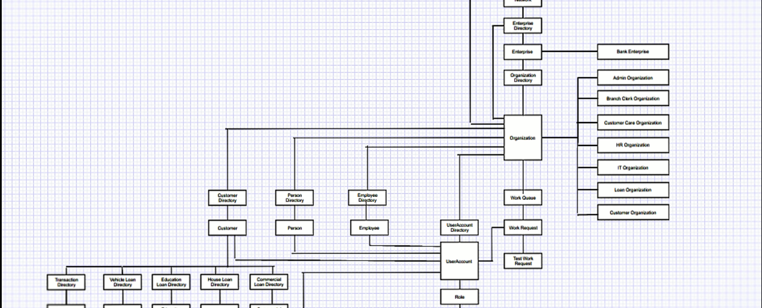
Object model

Slide 4
Key roles and responsibilities
SysAdmin Role : He will create the Networks,Enterprise and Enterprise Admin
Admin Role : He will create organizations, HR Role , IT officer.
HR Role : He will create the Branch Clerk ,Customer Care, Loan Officer.
IT Officer Role: He will view database information, View activity log and view requests.
Branch Clerk: He can open account ,deposit money, Contact HR,Manage cutomer’s Account
Loan Officer : He will sanction all the loan request send by the customers.
Customer Care Role: He will view the customer requests and can request IT team.
Customer Role: He can transfer money to another account,Request for different loans, contact customer care, view transaction history.

Slide 5
Key features
Customer can print the transaction directory.
User Id & Password of customer will be sent through email
HR can make announcement through email.
If any user will do unauthorized login more than 3 times an automated generated email will be send to his email Id.
HR can attach documents in mail.

Slide 6
Thank you

